Slide 1
PAGE ELEMENTS JDI

Slide 2

PLAN
UI Objects. JDI
JDI. Composite elements
JDI Settings
JDI for any UI

Slide 3
AGENDA
JDI ?
Simple Test
UI Objects
Simple Elements
Complex Elements

Slide 4
JDI?

Slide 5




Jdi setup
https://github.com/epam/JDI
http://jdi.epam.com/
https://vk.com/jdi_framework
README

Slide 6

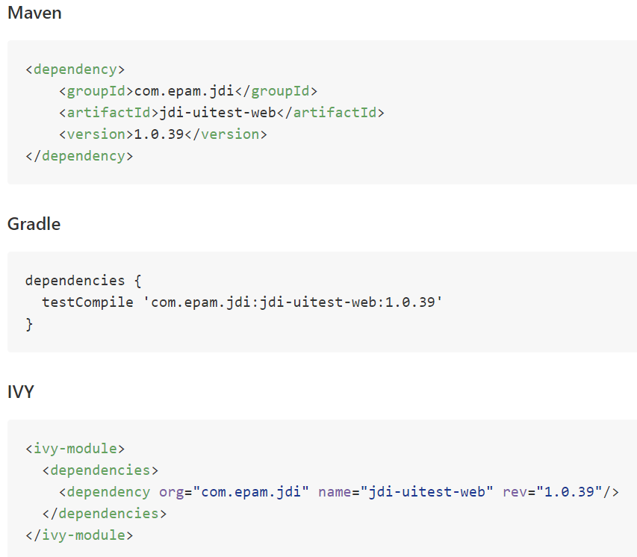
Jdi setup

Slide 7

Demo: Test project from scratch
Notes:
Demo Элементы на UI

Slide 8
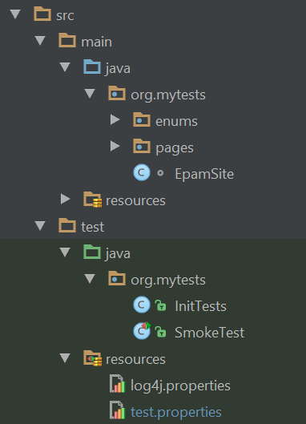
structure
test.properties
log properties
ui objects
test init
tests

Slide 9
SIMPLE TEST
ProductPage.ProductType.Select(«jacket»); ProductPage.Price.select(«500$»); ProductPage.Colors.check(«black», «white»);
Assert.isTrue(ProductPage.Label.getText(),
«Armani Jacket»)

Slide 10
SIMPLE TEST
LoginPage.Open();
LoginPage.LoginForm.Login(admin);
SearchPage.Search.Find(«Cup»);
Assert.AreEqual(ResultsPage.Products.Count(), expected);

Slide 11
DEMO: JDI UI OBJECTS
Notes:
LIVE demo
Есть готовые UI Objects. Переделка Селениум кода (с вейтами) под UI объекты

Slide 12
Page elements

Slide 13
Tests
Page Objects
Driver (Engine)
Application
PAGE OBJECTS
ELEMENTS
private WebElement UserName; private WebElement Password; private WebElement LoginButton;
ACTIONS
EnterUserName(String name);
EnterPassword(String name);
ClickLoginButton();
BUSINESS ACTIONS
Login(User user)

Slide 14
PAGE ELEMENTS
ELEMENTS
public TextField UserName; public TextField Password; public Button LoginButton;
ELEMENT
public DropDown UserStatus;
ACTIONS
Select(string option)
bool IsSelcted()
List<string> AllOptions()
string GetValue()
ACTIONS
---
BUSINESS ACTIONS
Login(User user)

Slide 15
PAGE ELEMENTS
ELEMENTS
public TextField UserName; public TextField Password; public Button LoginButton;
ELEMENT
public DropDown UserStatus;
ACTIONS
Select(string option)
bool IsSelcted()
List<string> AllOptions()
string GetValue()
ACTIONS
---
BUSINESS ACTIONS
Login(User user)

Slide 16
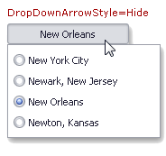
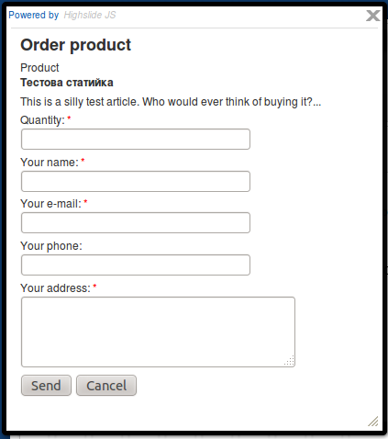

ELEMENTS
Simple
Complex
Composite

Slide 17
Simple elements

Slide 18



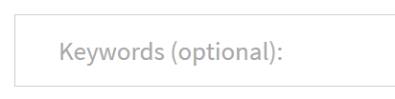
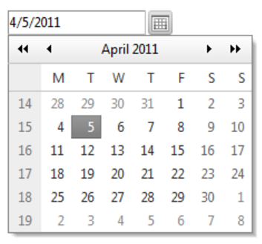



SIMPLE ELEMENTS
@FindBy (css=“.description”)
public Text description;
public Button submit;
public Label productName;
public Link followMe;
public TextField password;
public TextArea abuse;
public CheckBox rememberMe;
public DatePicker date;
public FileInput upload;
public Image photo;
NEWS

Slide 19

SIMPLE ELEMENTS
@FindBy (css=“.btn”)
public Button submit;
@FindBy (css=“.btn”)
@FindBy (xpath=“//button”)
@FindBy (id=“button-id”)
@FindBy (name=“button”)
@FindBy (css=“.btn”)
public Button submit =
new Button(By.css(“.btn”));
@JFindBy (text=“Submit”)
@JFindBy (model=“btn-model”)
@JFindBy (binding=“btn”)
@JFindBy (repeater=“r-button”)
@FindBy (css=“.btn”)
public IButton submit;

Slide 20


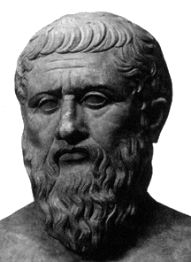

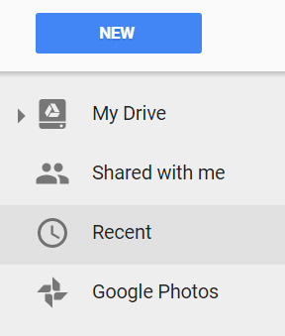

Plato's theory of Forms
IButton
No application but you can write UI Objects (Page Objects )
Notes:
Why we develop it?
Some people formulate it as “Why you create one more wheel”

Slide 21
DEMO: simple elements
Notes:
LIVE demo
Есть готовые UI Objects. Переделка Селениум кода (с вейтами) под UI объекты

Slide 22
DEMO: jfindby annotaion
Notes:
LIVE demo
Есть готовые UI Objects. Переделка Селениум кода (с вейтами) под UI объекты

Slide 23
complex elements

Slide 24

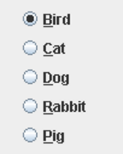
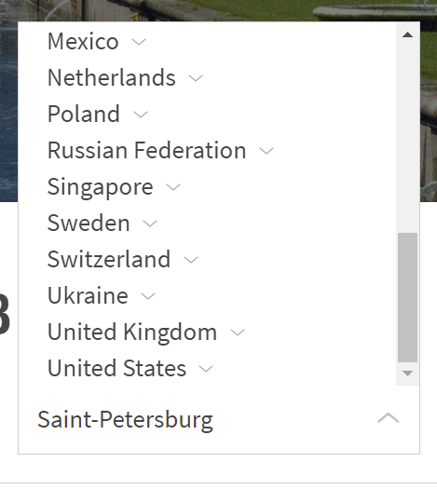
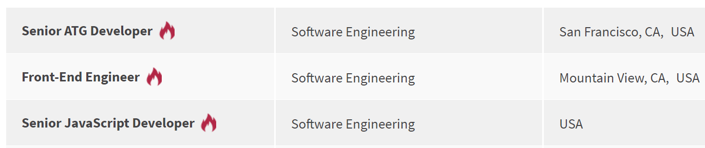
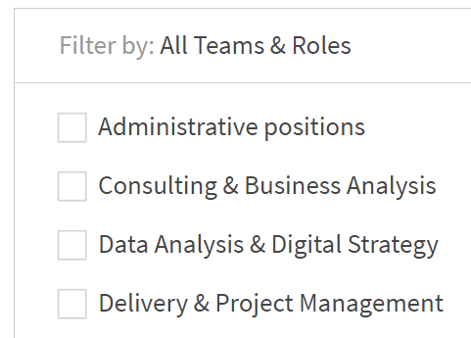
COMPLEX ELEMENTS
public Dropdown colors;
public Checklist settings;
public ComboBox tags;
public DropList shirtSizes;
public List<Element> searchResults;
public Elements reviews;
public Table products;
public Menu mainMenu;
public Tabs areas;
public Selector vote;
public RadioButtons rating;
public TextList chat;

Slide 25
COMPLEX ELEMENTS
@JDropdown (
root = @FindBy(css = “.colors"),
value = @FindBy(css = “.value"),
elementByName = @FindBy(tagName = “li"))
public Dropdown colors;
@JTable(
root = @FindBy (css = “.offers"),
row = @FindBy (xpath = ".//li[%s]//div"),
column = @FindBy (xpath = ".//li//div[%s]"),
header = {“ID", “Title", “Apply”} )
public Table offers;

Slide 26
COMPLEX ELEMENTS
@FindBy(css = “.colors")
public Dropdown colors;
@FindBy(css = “.table”)
public Table offers;
@FindBy(css = “.menu li”)
public Menu navigation;
@FindBy(css = “.menu ul”)
public Menu navigation;
@FindBy(xpath = “//*[@class=‘menu’]//li[text()=‘%s’]”)
public Menu navigation;

Slide 27
DEMO: COMPLEX ELEMENTS
Notes:
Demo Описание UI Objects

Slide 28
Using enums

Slide 29
Enums in Complex elements
public Menu<Options> topMenu;
public enum Options {
Home, About, Contacts }
topMenu.select(Options.About);
topMenu.select(About);
public Dropdown<Colors> colors;
public Tabs<Areas> areas;
public Checklist<Settings> settings;
public ComboBox<Tags> tags;
public DropList<Sizes> shirtSizes;
public Selector<VoteOptions> vote;
public RadioButtons<Ratings> rating;
public enum Options {
Home(‘option-1’),
About(‘option-3’),
public String value;
Options (String value) { this.value = value; }
@Override
public String toString() { return value; }
}

Slide 30
DEMO: using ENUMS
Notes:
Demo Замена Selenium Page Objects на JDI UI Objects

Slide 31
TYPIFIED ELEMENTS
Code readability
Clear behavior
Union of all element’s locators
Union of element and its actions
Detailed logging

Slide 32
COMPARE
Text Description;
Button Submit;
Label ProductName;
Link FollowMe;
TextField Password;
TextArea Abuse;
CheckBox RememberMe;
DatePicker Date;
FileInput Upload;
Image Photo;
WebElement Description;
WebElement SubmitButton;
WebElement ProductName;
WebElement FollowMeLink;
WebElement PasswordField;
WebElement Abuse;
WebElement RememberMe;
WebElement DatePicker;
WebElement Upload;
WebElement Photo;

Slide 33
COMPARE
@JDropdown (root = @FindBy(css = “.colors"),
value = @FindBy(css = “.value"),
elementByName = @FindBy(tagName = “li"))
Dropdown Colors;
@FindBy(css = “.colors .value")
WebElement ColorsValue;
@FindBy(css = “.colors li")
List<WebElement> ColorsList;
public string getColor() {
return ColorsValue.getText();
}
public void selectColor(string colorName) {
ColorsValue.Click();
for (WebElement color : ColorsList)
if (color.getText().Equals(colorName) {
color.Click();
return;
}
}

Slide 34
COMPARE
@FindBy (id = “trades")
public Table Colors;
@FindBy(css = "")
private List<WebElement> resultsColHeaders;
@FindBy(css = "")
private List<WebElement> resultsRowsHeaders;
@FindBy(css = "")
private List<WebElement> resultsCellsHeaders;
@FindBy(css = "")
private List<WebElement> resultsColumn;
@FindBy(css = "")
private List<WebElement> resultsRow;
ICell cell(Column column, Row row) { }
ICell cell(String columnName, String rowName) { }
ICell cell(int columnIndex, int rowIndex) { }
List<ICell> cells(String value) { }
List<ICell> cellsMatch(String regex) { }
ICell cell(String value) { }
ICell cellMatch(String regex) { }
MapArray<String, MapArray<String, ICell>> rows(String... colNameValues) { }
MapArray<String, MapArray<String, ICell>> columns(String... rowNameValues) { }
boolean waitValue(String value, Row row) { }
boolean waitValue(String value, Column column) { }
boolean isEmpty() { }
boolean waitHaveRows() { }
boolean waitRows(int count) { }
ICell cell(String value, Row row) { }
ICell cell(String value, Column column) { }
List<ICell> cellsMatch(String regex, Row row) { }
List<ICell> cellsMatch(String regex, Column column) { }
MapArray<String, ICell> row(String value, Column column) { }
MapArray<String, ICell> column(String value, Row row) { }
MapArray<String, ICell> row(int rowNum) { }
MapArray<String, ICell> row(String rowName) { }
List<String> rowValue(int colNum) { }
List<String> rowValue(String colName) { }
MapArray<String, ICell> column(int colNum) { }
MapArray<String, ICell> column(String colName) { }
List<String> columnValue(int colNum) { }
List<String> columnValue(String colName) { }
MapArray<String, SelectElement> header() { }
SelectElement header(String name) { }
List<String> headers() { }
List<String> footer() { }
List<ICell> getCells() { }
void clean() { }
void clear() { }
ITable useCache(boolean value) { }
ITable useCache() { }
Table clone() { }
Table copy() { }
ITable hasAllHeaders() { }
ITable hasNoHeaders() { }
ITable hasOnlyColumnHeaders() { }
ITable hasOnlyRowHeaders() { }
ITable hasColumnHeaders(List<String> value) { }
<THeaders extends Enum> ITable hasColumnHeaders(Class<THeaders> headers) { }
ITable hasRowHeaders(List<String> value) { }
<THeaders extends Enum> ITable hasRowHeaders(Class<THeaders> headers) { }
ITable setColumnsCount(int value) { }
ITable setRowsCount(int value) { }

Slide 35
DEMO: TYPIFIED elements
Notes:
Demo Замена Selenium Page Objects на JDI UI Objects

Slide 36
NEXT
UI Objects. JDI
JDI. Composite elements
JDI Settings
JDI for any UI

Slide 37



Questions
roman.Iovlev
roman_iovlev@epam.com

